Slide 1
Intel’s SGX
Some of the slides borrowed from Intel
Innovative Instructions and Software Model for Isolated Execution, HASP 2013 (F. McKeen et. al.)

Slide 2
Reduced Attack Surface with SGX
Normally
With SGX enabled
App
App
App
App
App
App
OS
OS
VMM
VMM
Hardware
Hardware
Attack Surface
Malware that can subvert any one of
app, OS, VMM, or hardware
can steal secrets
Small attack surface (App + Hardware)
Malware cannot steel secrets inspite of subverting OS, BIOS, VMM, most
parts of the App, etc.

Slide 3
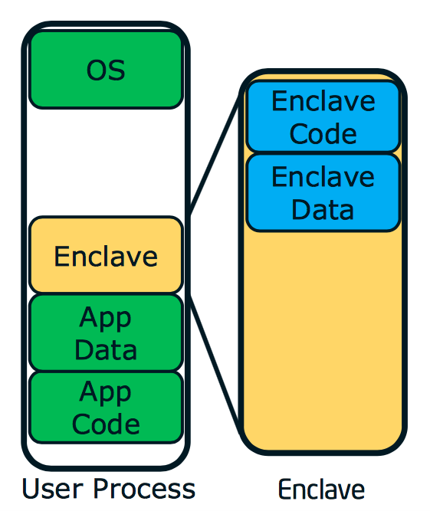
Enclaves (reverse sandbox)
Enclave has its own code and data areas
Provides confidentiality and integrity
With controlled entry points
However, enclave code and data cannot be accessed from outside the enclave not even by the operating system.
TCS: Thread control Structure
(SGX supports multi-threading; one TCS for each thread supported)
Entry Table
Enclave Heap
Enclave Stack
Enclave Code
TCS

Slide 4
Enclave Properties
Achieves confidentiality and integrity
Tampering of code / data is detected and access to tampered code / data is prevented.
Code outside enclave cannot access code/data inside the enclave
Even though OS is untrusted, it should still be able to manage page translation and page tables of the enclave
Enclave code and data
Enclave code and data is in the clear when in the CPU package (eg. Registers / caches), but unauthorized access is prevented
Enclave code and data is automatically encrypted it leaves the CPU package
Notes:
IF a software attacks and tries to modify code; it is detected and SGX will prevent access to the tampered code and data
Memory probing attacks can be prevented this way

Slide 5
Physical Memory
PRM – processor related memory allocated by the BIOS. Access to PRM is blocked by external agents such as DMA, graphics engine, etc.)
To the other devices, this range is treated as non-existent memory
All SGX enclaves mapped into the PRM
EPC Pages: Enclave page cache holds enclaves from any application.
Divided into 4KB pages
If an EPC page is valid, it either contains an SGX enclave page or EPCM (EPC micro-architecture structure)
PRM
EPC
EPCM
RAM

Slide 6
SGX Enclaves and PRM
Process 1
Process 2
Virtual address to physical address mapping. Done by OS and MMU
RAM
Virtual Memory
Virtual Memory

Slide 7
Physical Memory
EPCM: Enclave page cache map
one for each EPC
Used by hardware for access control
It stores management related aspects for the corresponding EPC
Aspects such as valid / invalid; r/w/x permissions
Type of page
Virtual address range through which, the EPC can be accessed
It is an additional layer of security compared to legacy paging and segmentation since we do not trust the OS
PRM
EPC
EPCM
RAM

Slide 8
Physical Memory
SECS: SGX Enclave Control Store
One for each enclave
4KB (present in an EPC)
Contains global metadata about the enclave
EPC pages that are used
Mapping information
Crypto log of each used EPC page
Range of protected addresses used by the enclave
32 / 64 bit operating mode
Debug access
SECS
PRM
EPC
RAM

Slide 9
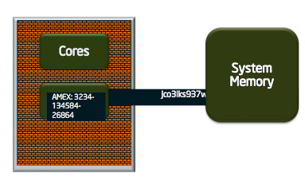
EPC Encryption
Hardware unit that encrypts and protects integrity of each EPC

Slide 10
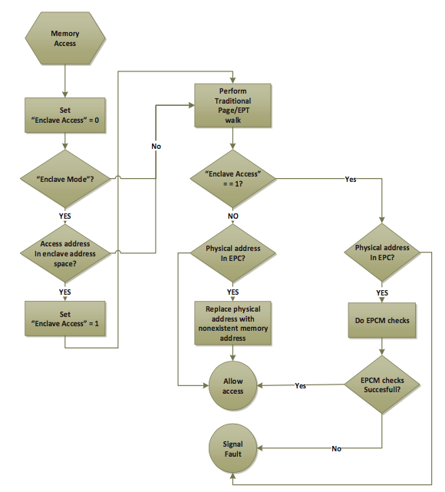
Memory Access
x

Slide 11
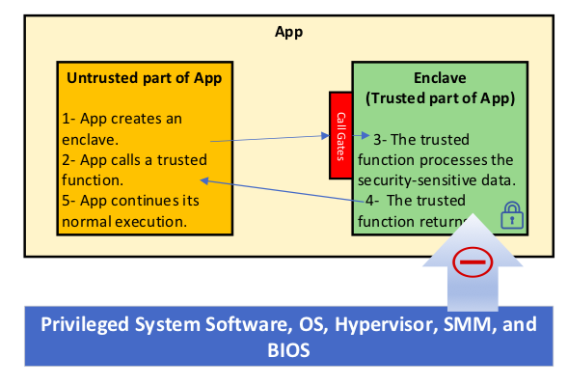
Application Execution Flow
App built with trusted and untrusted part
Untrusted part creates and executes the enclave
Enclave is placed in the EPC. It is encrypted and trusted
Trusted function is called and execution is transferred into the enclave
Trusted function executes
Trusted function returns
Application continues execution

Slide 12
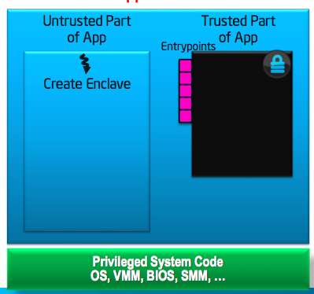
Enclave Life Cycle (creation)
ECREATE Instruction
Creates a SECS (SGX enclave control structure)
Contains global information about the enclave
System software can choose where (in the process virtual space) the enclave should be present
Also specifies
Operating mode (32/64 bit)
Processor features that is supported
Debug allowed
Process

Slide 13
Enclave Life Cycle (adding pages)
EADD Instruction
System software should select free ECS page
EADD will initialize EPCM with
Page type (TCS / REG)
Linear address that will access the page
RWX permissions
Associate the page in SECS structure
EADD will then record EPCM information in a crypto log stored in the SECS
This is the measurement of the enclave
Used for gaining assurance
Copy 4K bytes of data from unprotected memory into the enclave
Process

Slide 14
Enclave Life Cycle (measuring pages)
EEXTEND
Measure a 256 byte region in an EPC page
This region is specified by the developer
The measurement comprising of a 64 bit address and a 256 byte information in the SECS
16 invocations EEXTEND needed to measure the whole page
Correct construction of the enclave would result in a matching with the enclave owner
The enclave owner’s signature is stored in a SIGSTRUCT structure
This can also be remotely verified
Process

Slide 15
Enclave Life Cycle (initializing pages)
EINIT
Should be invoked after all pages have been added
Verify that the signature matches that of the owner’s signature
If EINIT is successful, it allows the enclave to be entered
Process

Slide 16
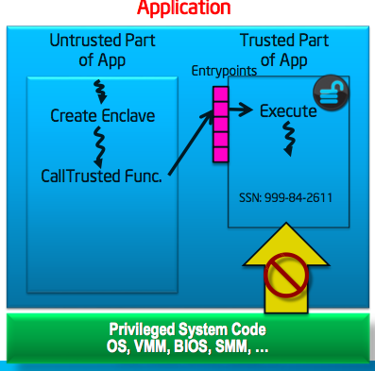
Enclave Life Cycle (enter/exit)
Process invokes the enclave through
pre-defined entry points using EENTER
instruction
EENTER
Changes made to enclave mode
Need to know the location to transfer control and location where to save state in case of an interrupt
Defines an Asynch. Exit pointer, which where IRET returns to after servicing an interrupt
It is outside the enclave
And typically will have an instruction ERESUME

Slide 17
Entry into the Enclave
Set TCS to busy
Change mode to enclave mode
Save state of SP, BP, etc. for return in case of async. Exit
Save AEP
Transfer control from outside the enclave to inside

Slide 18
Exit from Enclave
EEXIT
Clear enclave mode and flush TLB entries
Mark TCS as free.
Transfer control outside the enclave

Slide 19
Asynchronous Exit (AEX)
Occurs when an interrupt / exit occurs
Processor state is securely saved inside the enclave and replaced with synthetic states
AEP pushed onto the stack (AEP is a location outside the enclave where execution goes to after IRET)
After AEX completes, the logical processor is no longer in enclave mode
Resuming after an interrupt
EERESUME instruction is invoked, which restores all registers
Typically EERESUME is present at the AEP location
Resuming after a fault that occurred in the enclave?
Eg. A divide by zero
Notes:
Re-issue eenter, instruction

Slide 20
Instruction set Extensions for SGX
Privileged Instructions
Creation related: to create, add pages, extend, initialize, remove enclave
Paging related: evict page, load an evicted page
User level instructions
Enter enclave, leave enclave
Interrupt related: asynchronous exit, resume

Slide 21

Points to Ponder
Compare Intel SGX with ARM Trustzone
What is the attacker assumption in each case?
Why does SGX encrypt data in memory while Trustzone does not?

